Slide 1

Big Data Graduation Project
Presented by: Hassan Hosny Hassan
Presented to: Eng. Ahmed Reda,
Eng. Amr Saleh

Slide 2
Workflow
Data Ingestion
Data storage
Data analysis
Data visualization

Slide 3


Data Ingestion & Data storage
Upload dataset “covid-19.csv” into VM using WinSCP into landing zone name it “/home/cloudera/covid_project/landing_zone/COVID_SRC_LZ”
Load the dataset from “COVID_SRC_LZ” to HDFS directory name it “/user/cloudera/ds/COVID_HDFS_LZ” using HDFS cli commands in a shell script

Slide 4

Data Analysis using HIVE
Create
Create three tables: a staging table for initial data import, and two additional tables for partitioning and data preparation.
Fill
Fill missing values in the data and partition it for improved accessibility.
Rank
Finally, rank the data in the final table based on {Total_deaths, Total_tests} using {DENSE_RANK()}

Slide 5
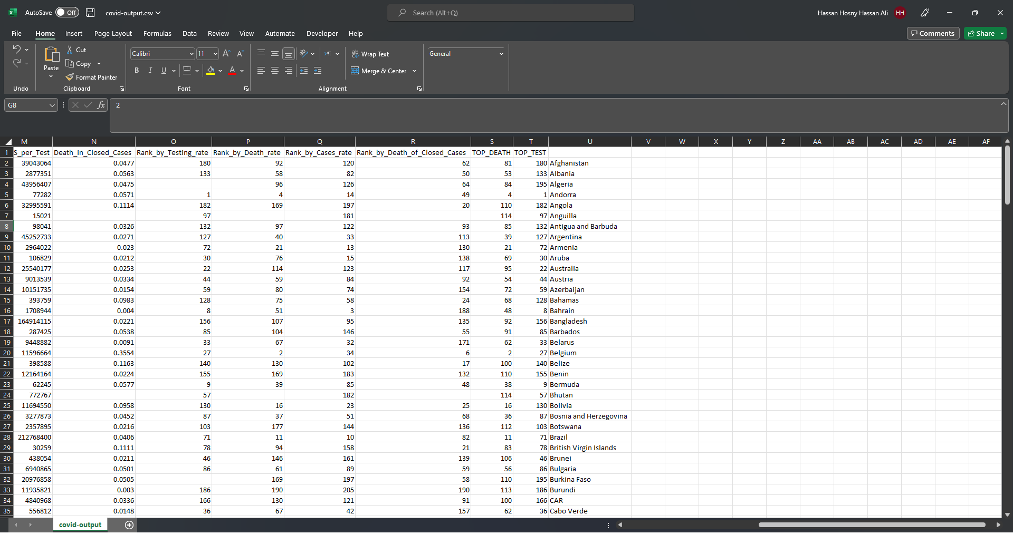
A snippet from the output

Slide 6
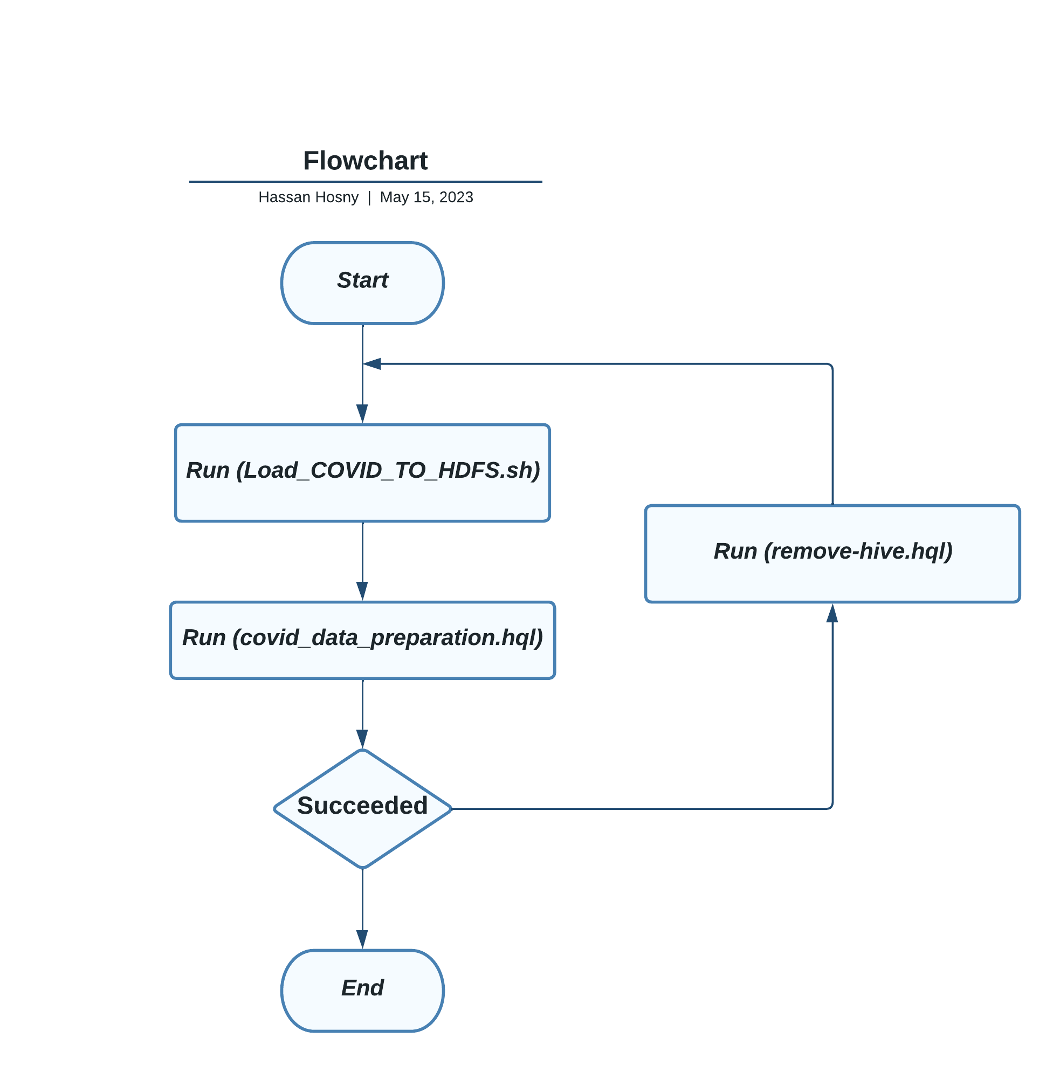
Data Analysis Flowchart

Slide 7
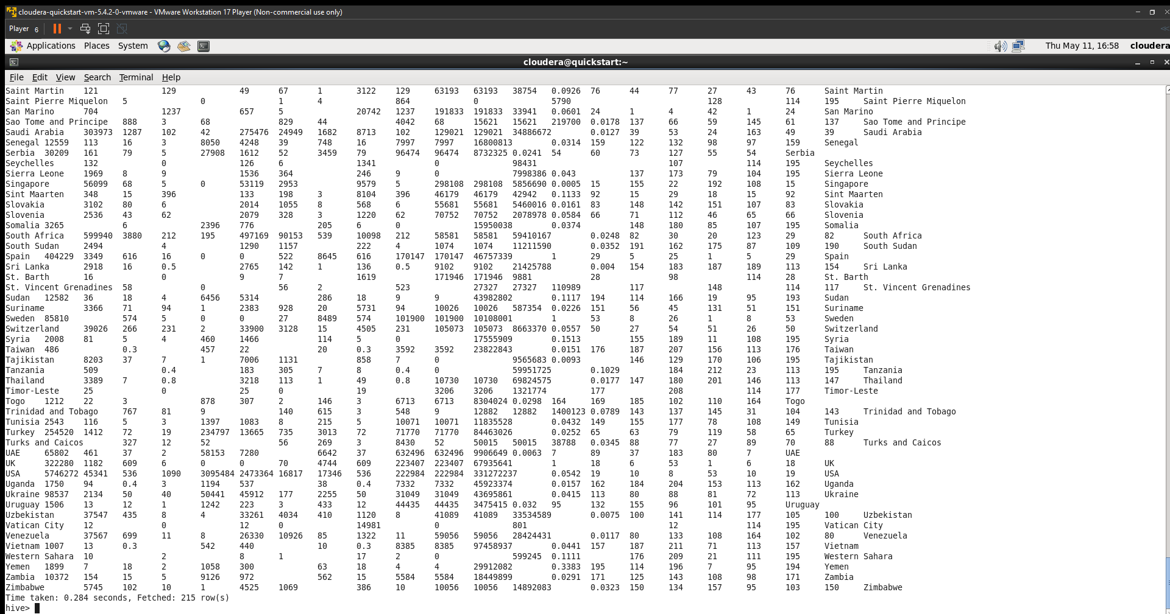
A snippet from the output after running "covid_data_preparation.hql".
Fetched 215 row(s)

Slide 8
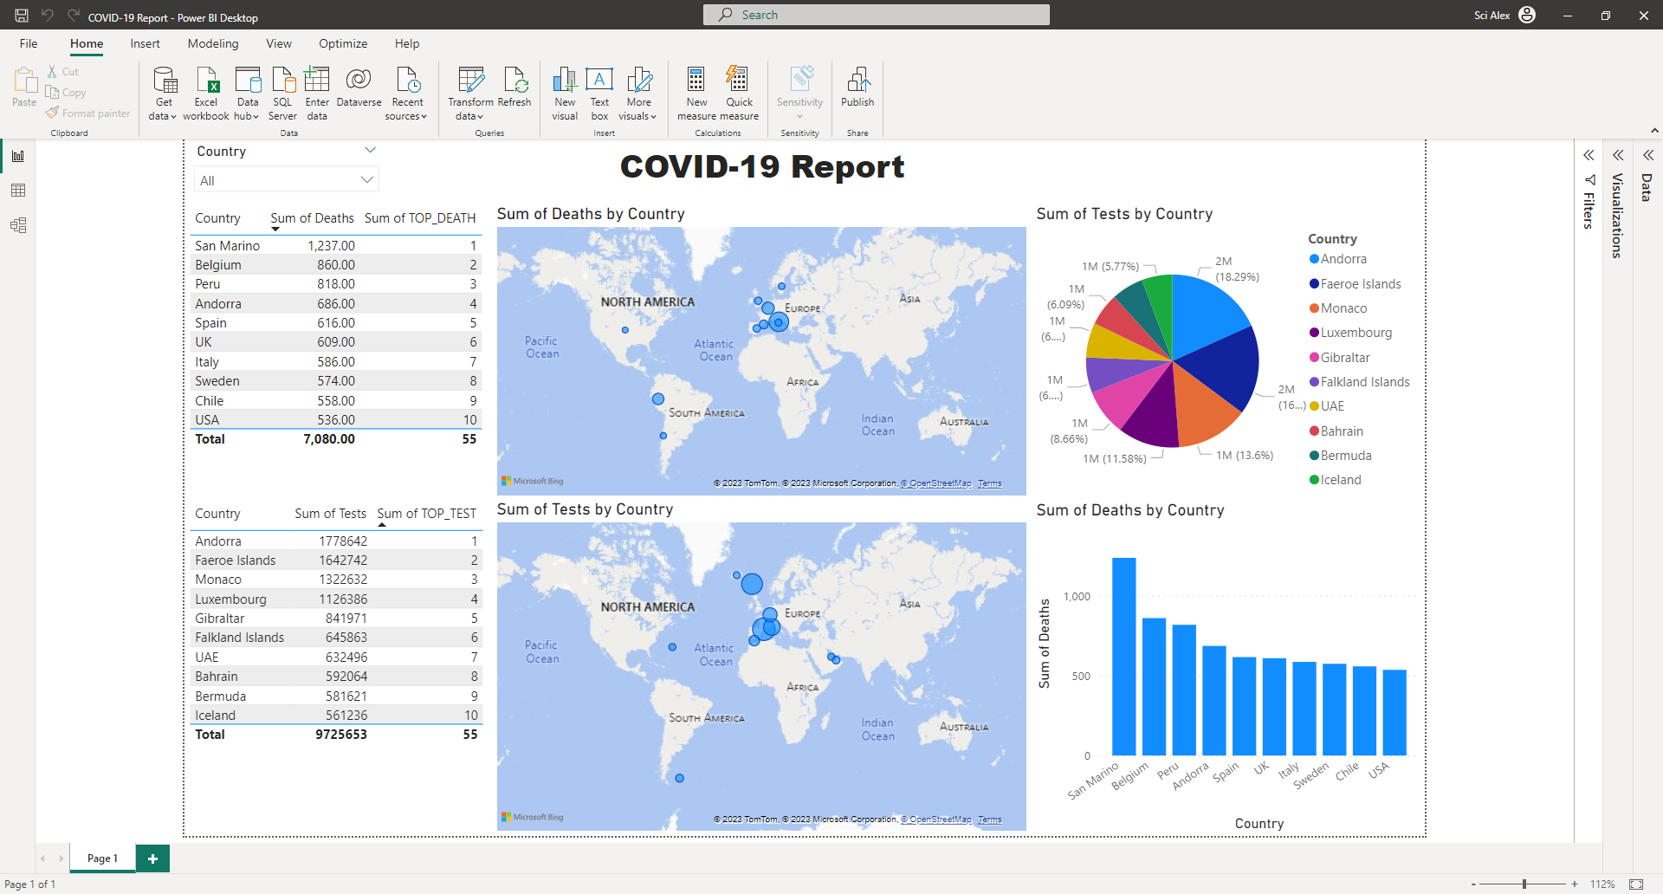

Slide 9

Data visualization
The top 10 countries with the highest death rates are shown on the map.
The top 10 countries with the highest testing rates are shown on the map.
The top 10 countries with the highest testing rates are displayed on a pie chart.
A bar chart displaying the total number of deaths for each country.
To provide a comprehensive visual representation, I can include two additional tables alongside the maps. In the first table, I will display the sum of deaths and the country with the highest number of deaths. In the second table, I will show the sum of tests conducted and the country with the highest number of tests.

Slide 10
Oozie workflow
Oozie is a tool that helps you schedule and coordinate different tasks in a Hadoop environment. It's like a manager for your data processing workflows. You can use Oozie to define and organize complex jobs like MapReduce, Hive, etc.
I found it challenging to create this workflow, even though it may appear straightforward to use.
I didn't initially realize that I have to delete the database every time I run this workflow.

Slide 11
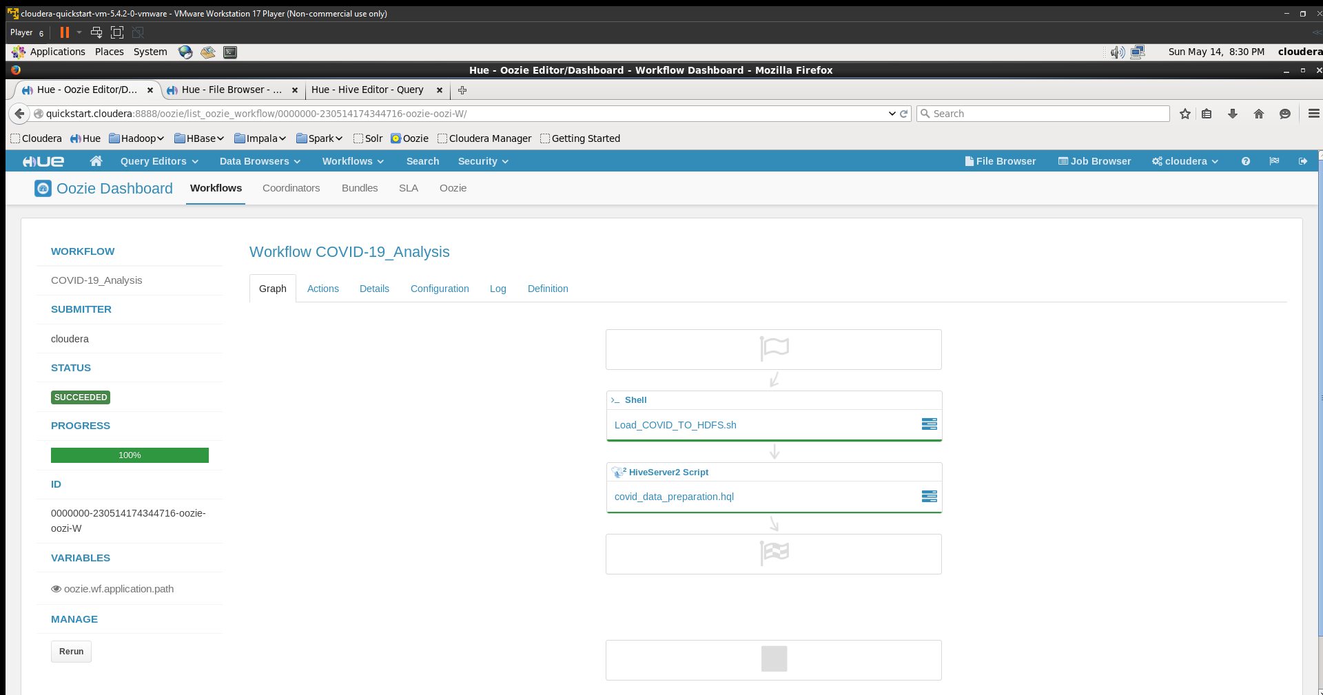
A snippet from the output

Slide 12
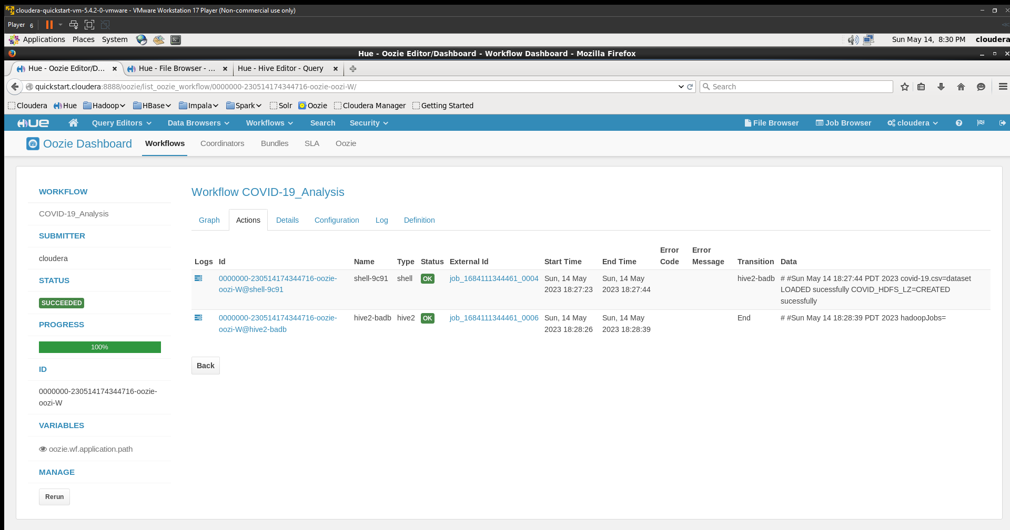

Slide 13

Project resources
Github: COVID-19
Google drive: COVID-19

Slide 14

Thank you in advance :-)

